Slide 1
A System for Rapid Exploration of Shader Optimization Choices
Yong He (Carnegie Mellon University)
Tim Foley (NVIDIA)
Kayvon Fatahalian (Carnegie Mellon University)
Notes:
It’s hard to optimize the performance of a modern game, and it would be nice if we have better compilers or tools to help us rapidly optimize these systems. What I am going to present today is a first step towards this goal, which is a system that rapidly explore shader optimization choices.

Slide 2
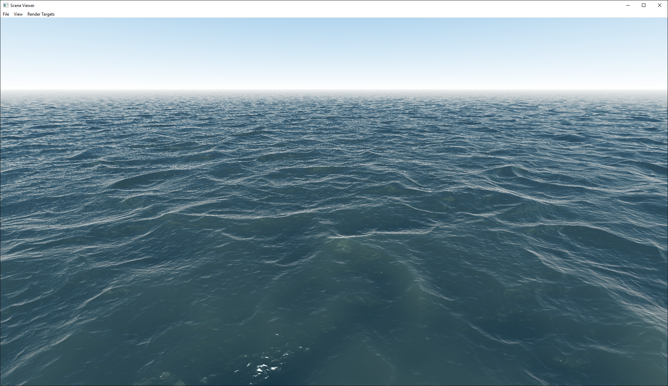
Example 1: Water Rendering via Ray Marching
Notes:
Let’s look at this complex water shader which you may see in modern games.
here is a water rendering algorithm taken from shader toys. The algorithm works as a post-processing pass, that is, ||

Slide 3
Example 1: Water Rendering via Ray Marching
For every pixel on screen:
1: Ray Marching Procedural Water Surface
2: Compute Shading
Notes:
we render a full screen quad, || then in the fragment shader, we shoot a ray from each pixel and compute the intersection with a procedural height field, and then shade the intersection point using a standard lighting model.

Slide 4
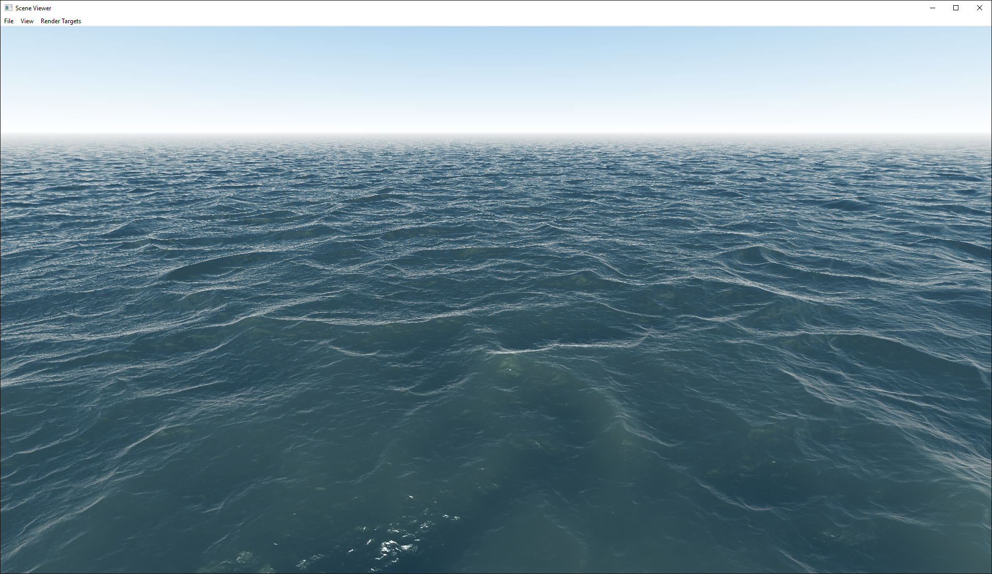
Example 1: Water Rendering via Ray Marching
8.0 ms
Notes:
However a naïve implementation like this can be too slow for games. ||

Slide 5
Example 1: Water Rendering via Ray Marching
5.1 ms
Simple Wave Function
Notes:
An one common way to optimize a shader is to simplify the expressions. For example we can use a simpler wave function that evaluates fewer iterations. But local optimizations like this cannot get you very far.

Slide 6
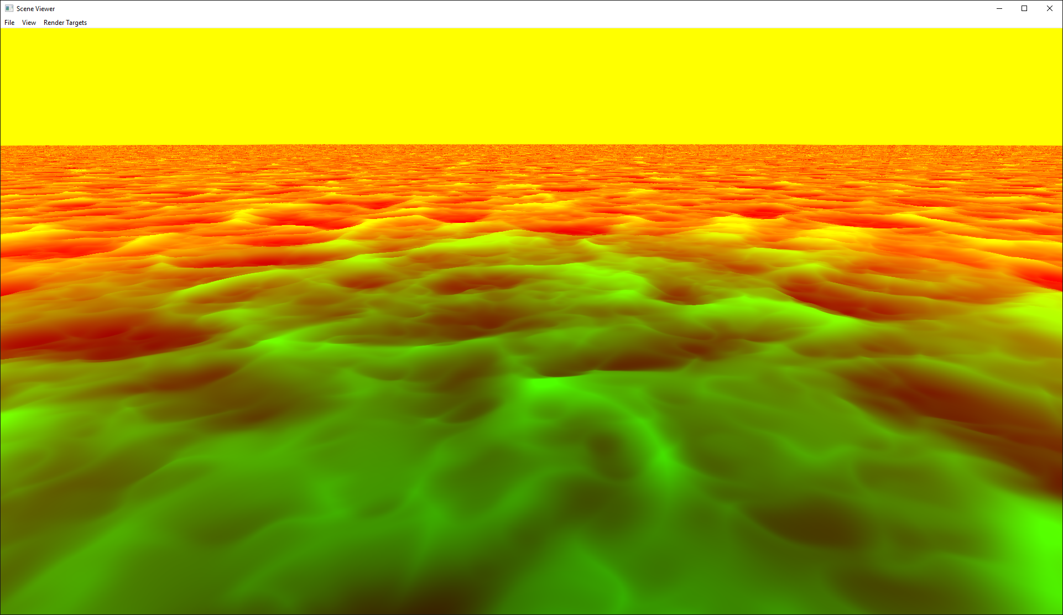
Example 1: Water Rendering via Ray Marching
Visualization of ray intersections
R Channel: distance to viewer
G Channel: world space Y
5.1 ms
Notes:
To further optimize this shader, we need to apply more advanced optimizations. Since computing the ray interesections is very expensive, it is worthwhile to do it at lower spatial rate, (such as at..

Slide 7

Example 1: Water Rendering via Ray Marching
Visualization of ray intersections
R Channel: distance to viewer
G Channel: world space Y
3.2 ms
Notes:
such as at half screen resolution. || And if we compute the normal and shade it at full resolution,

Slide 8
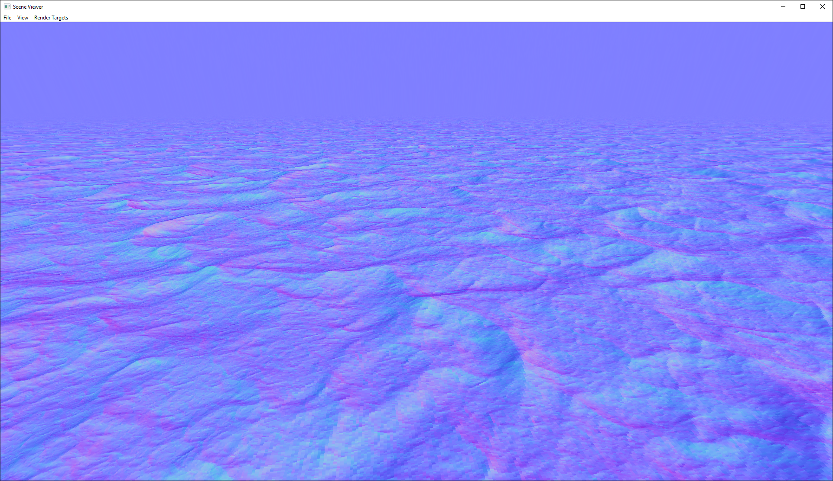
Example 1: Water Rendering via Ray Marching
3.2 ms
Visualization of normals
Notes:
such as at half screen resolution. || And if we compute the normal and shade it at full resolution,

Slide 9
Example 1: Water Rendering via Ray Marching
3.2 ms
Notes:
it still looks fine, but now runs much faster.

Slide 10
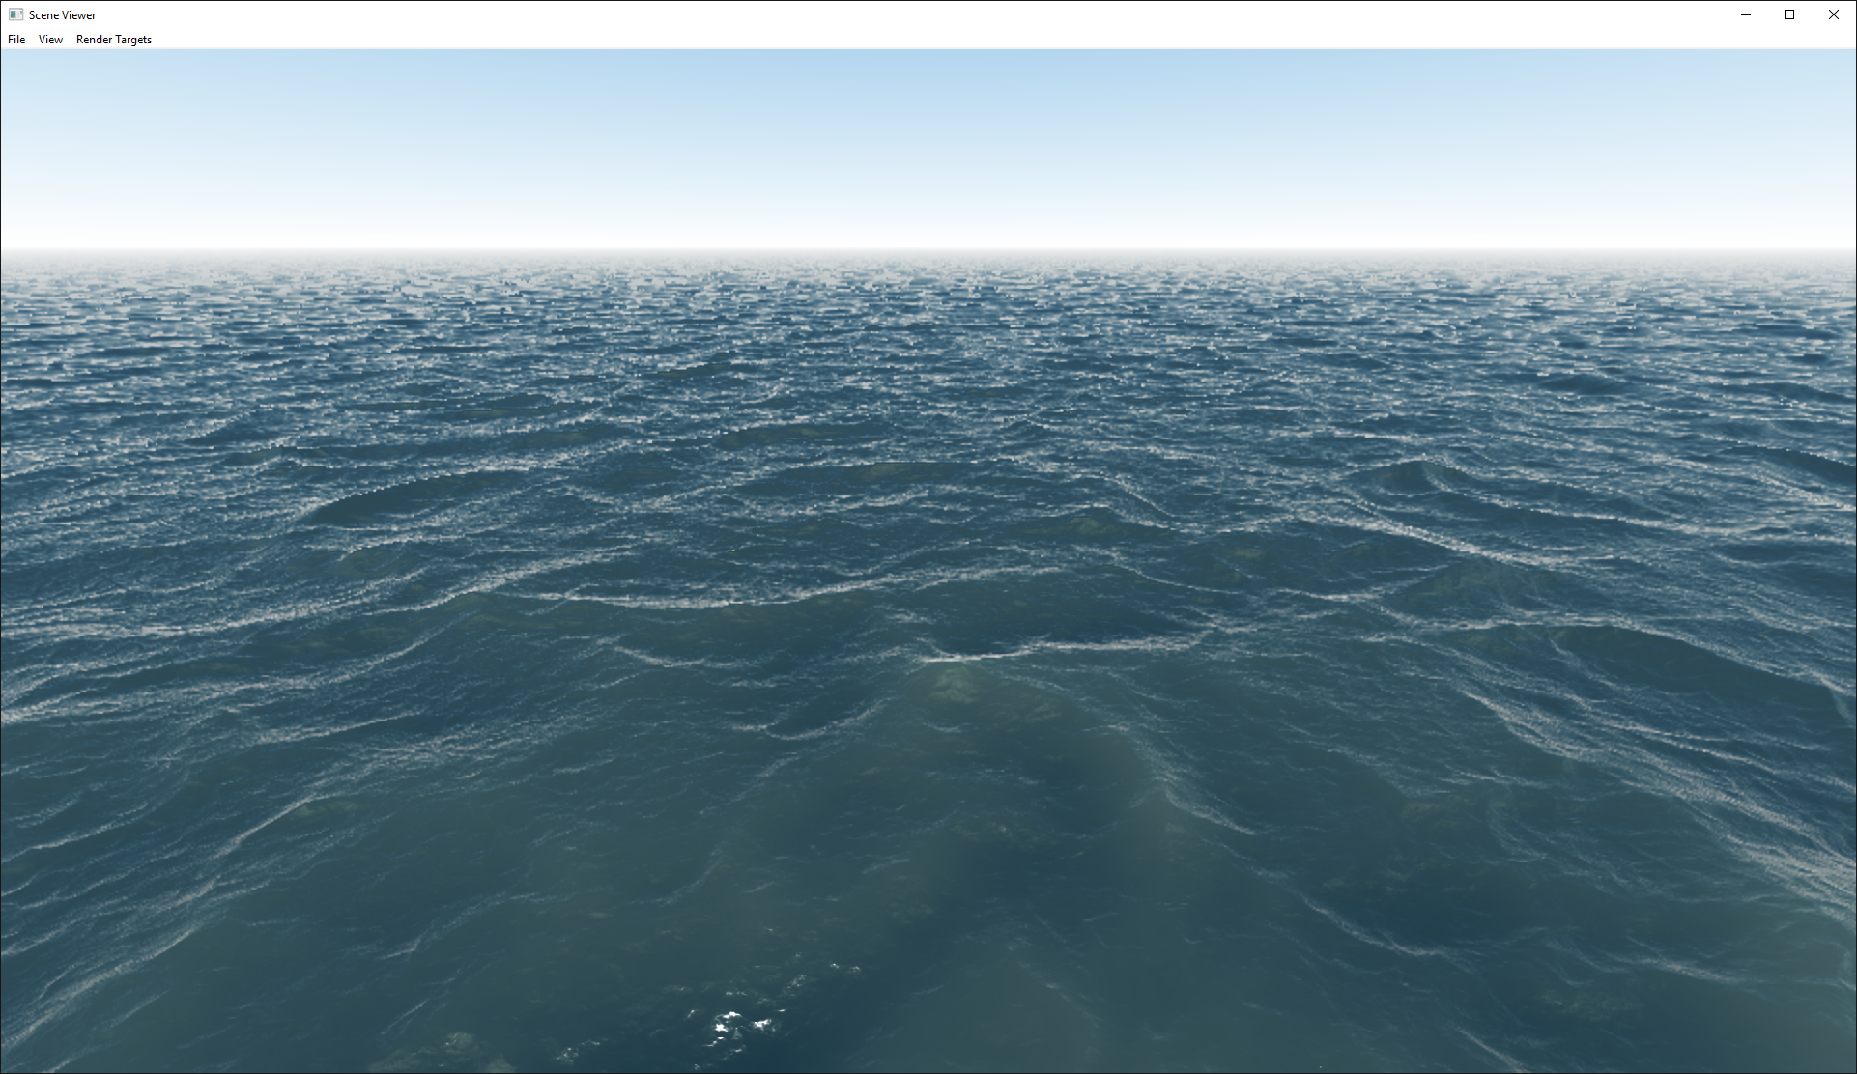
Example 1: Water Rendering via Ray Marching
2.4 ms
Notes:
Of course, if you are willing to sacrifice performance, we can also compute the normal at half resolution, that will further improve the performance.

Slide 11
Implementing an optimization is not as easy as it sounds
Render Pass 1 – Half Resolution
Render Pass 2 – Full Resolution
Ray Marching Procedural Water Surface
Computes Normals and Shading
Vertex Shader
Ray Marching Fragment Shader
Vertex Shader
Shading Only Fragment Shader
Texture Buffer
(Intersection Points)
Notes:
Even though it is easy to describe, actually implement this optimization is a lot more than just modifying the fragment shader. ||
To carry out the optimization, we require two render passes, one that runs in half screen resolution and the second pass in full resolution. So that means the renderer code has to change. || Also, Instead of writing one fragment shader, we need to write two sets of vertex and fragment shaders. That means all shaders need to be re-written. || And lastly we have to allocate an intermediate texture that stores the intersection points.
As you can see, this is a lot of non-trivial work to implement a simple optimization.

Slide 12
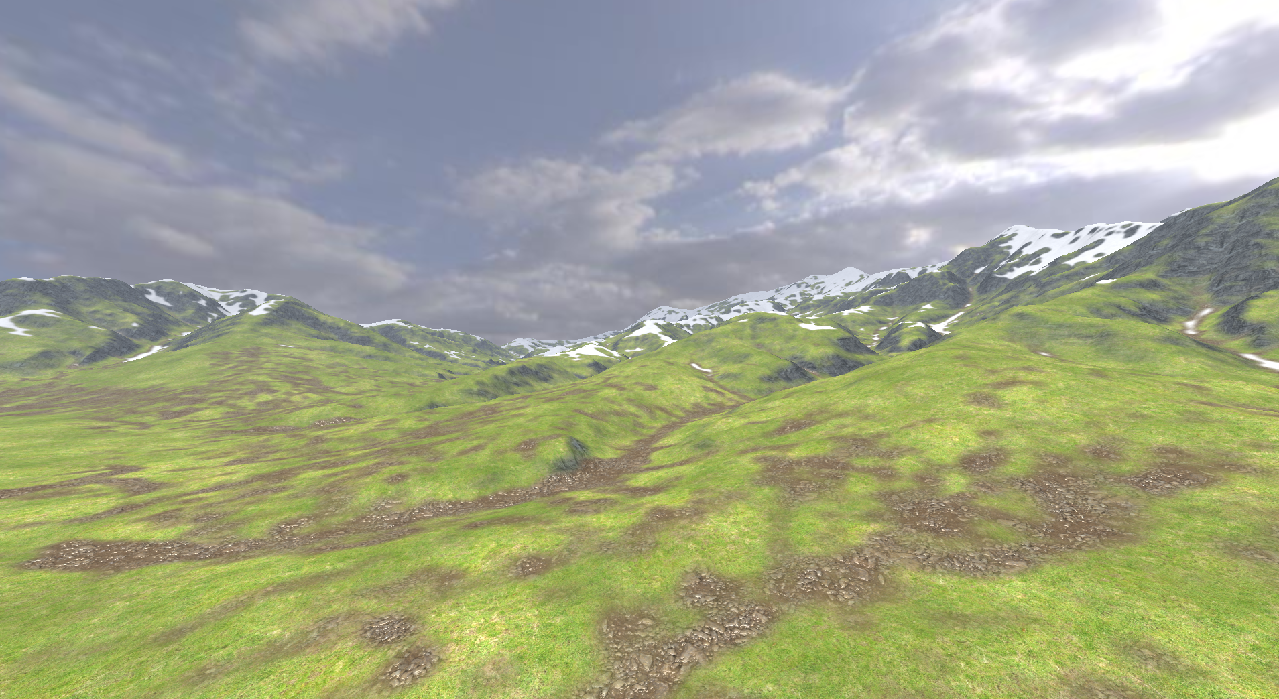






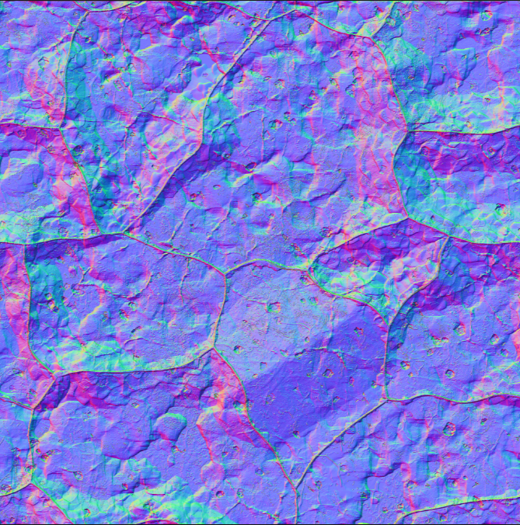




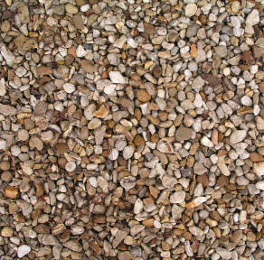
Example 2: Terrain Rendering
Rendering Algorithm:
Blend Several Layers of Material
Snow
Grass1
Grass2
Soil
Rock
Pebbles
Notes:
Previous example is about reduce computation rate spatially, but another commonly used optimization is to reduce temporal rate that is compute some terms once and reuse over frames. Here’s another example: this complex terrain shader evaluates and blends many different material layers.

Slide 13


Example 2: Terrain Rendering
Optimization: Precompute blended appearance
Compute Shader
Fragment Shader
(Single Texture Fetch)
Executed Once
Executed Every Frame
Notes:
When complex materials are too expensive to evaluate, a common technique is to combine the textures offline into a single texture and use that in the fragment shader. Notice this can be done offline as a precomputation or can be done on-demand as the game is running.
||
Unlike the previous example, here I am computing the value at a lower temporal rate instead of spatial rate.
But like the prev example, this is also an optimization that is simple to describe but requires rewriting a lot of non-trivial engine and shader code.

Slide 14
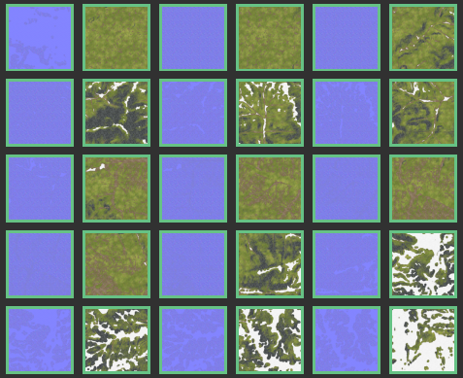
Example 2: Terrain Rendering
Implementation 3: Dynamic Texture Cache
pre-rendered textures for currently visible terrain blocks
Compute Shader
Fragment Shader
fetching cached textures
compute blended material in object space
Notes:
use a texture cache that stores only the pre-rendered textures for visible terrain blocks only. These textures can be managed by the engine and re-rendered on-demand.
So, as you can see, the actual implementation of a simple shading algorithm can involve many different concerns and require a lot of human effort. implement.

Slide 15
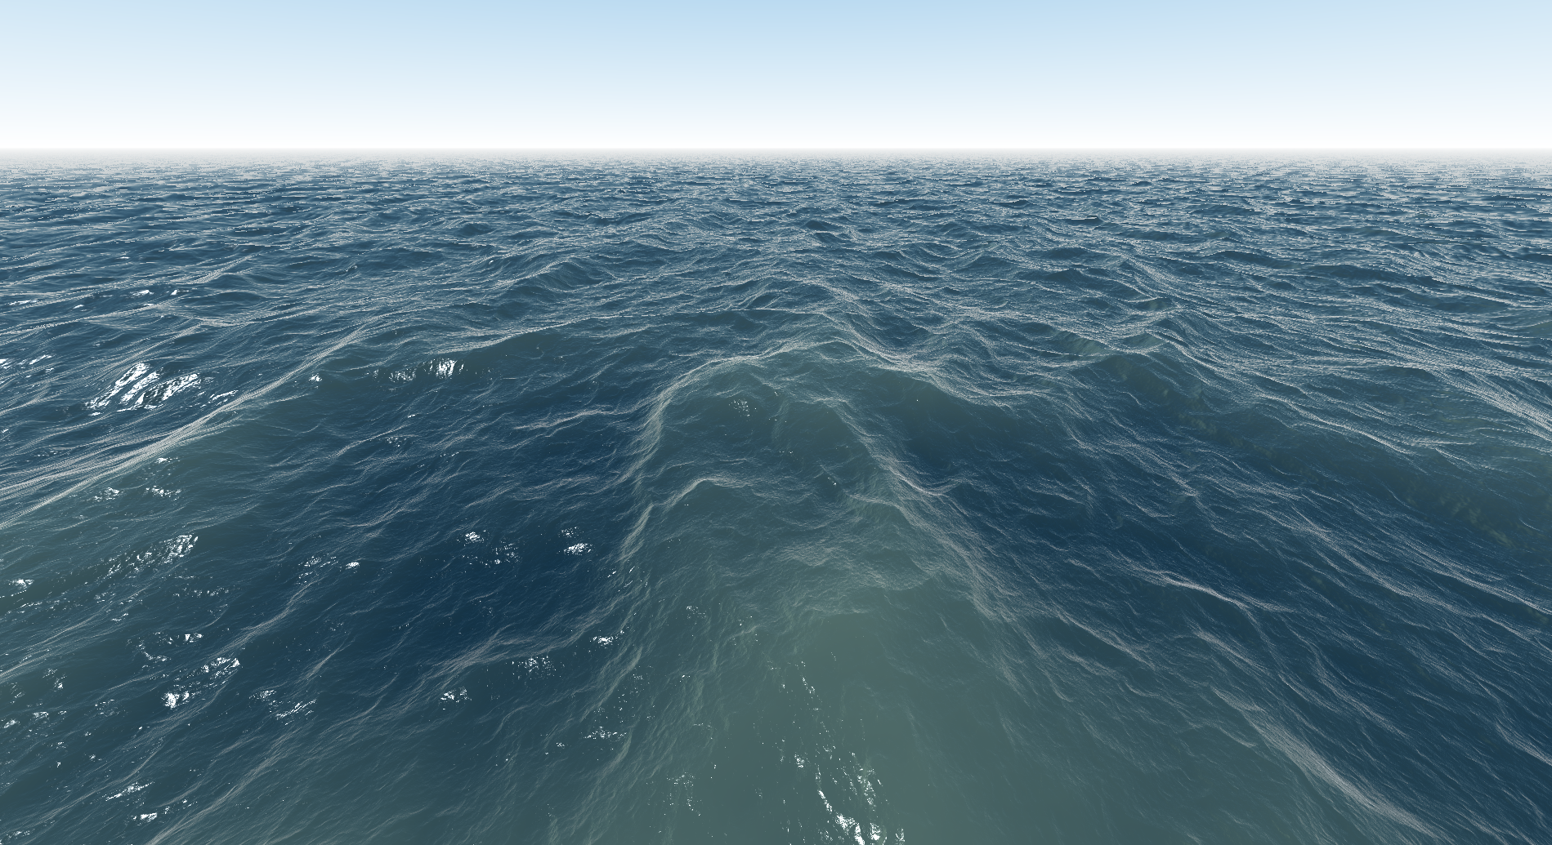
Goal: A system that generates different implementations from a high level representation
“compute everything
in fragment shader”
Implementation 1
Ray-Casting
Water Rendering Algorithm
Compile
Vertex Shader
Fragment Shader
Engine Code
“ray marching
at half res”
Implementation 2
Compile
Vertex Shader 1
Fragment Shader 1
Vertex Shader 2
Fragment Shader 2
Engine Code
Notes:
(depth first)
The goal of my research is to allow you to describe the optimizations as easy as we just did, and the system does the time-consuming work to actually implement the optimization choices for you, or even automatically figure out what are the right set of optimizations to apply. || For example, I would like to just write the water rendering shader once, and || tell the compiler that i want to compute everything in fragment shader, || and the compiler will generate entire shader and pipeline code for me, or || I can also say “do ray marching at half resolution”, || and I will get another implementation.

Slide 16
Contribution:
Spire: a new representation (compiler IR) for shaders
Enables rapid exploration of different performance-quality trade-offs spanning multiple render passes (offline processing, object space and screen space shading)
Supports building tools that automatically exploring optimization choices (auto-tuning)
Not specific to any particular rendering engine
Notes:
(we are going to show that system does x y z )
We’ve take a first step towards this goal, not for the entire game engine but for implementing different optimizations of shading algorithms. ||
We developed a system which we called Spire, and it is a new representation for shaders that enables rapid exploration of different optimization trade-offs, and generates shader code spanning many rendering passes across the engine. ||
We are going to show you that spire is an excellent basis for building tools of automatic exploration ||
and you can use all the services of Spire in any game engine without modifying the compiler itself.

Slide 17
Spire Abstractions
Notes:
Now let me show you the abstractions of spire in detail.

Slide 18
Shader is graph generate code using pipeline def optimization is overloading (summary slide) Shader – data flow graph (nodes = components, no vertex shader no fragment shader) but we need to run it – some nees to go to vertex shader som e to fragment, so compiler needs to generate these shading stages, but how does it know what to go where? So we have to describe to the compiler what are choices and what are the places that is allowed. Pipeline is a set of worlds and data dependency connections. Let’s go back to the shader, pipeline defines certain inputs and outputs, given this constraints the rest of component are free to be placed any where you want. A shader program I have written has many different impls based on where the comps are placed. Two types of component overloads. (Better way to think about it is the components is overloaded at three worlds : there are three different implementations for this component that is defined in lowRes, VS, ..) a smart shader programmer may want to say that if I am computing a component at certain world I may use another implementation, and spire allows that (explicit world overloading), and of course you can do algorithmic overloading. In our system, we treat optimizaitons as picking overloaded component definitions, 1) overloading on world placement 2) algorithmic overloading. (why need the concept before what) (show code -> shader graph -> shader graph with code)
Notes:
Road map point important

Slide 19
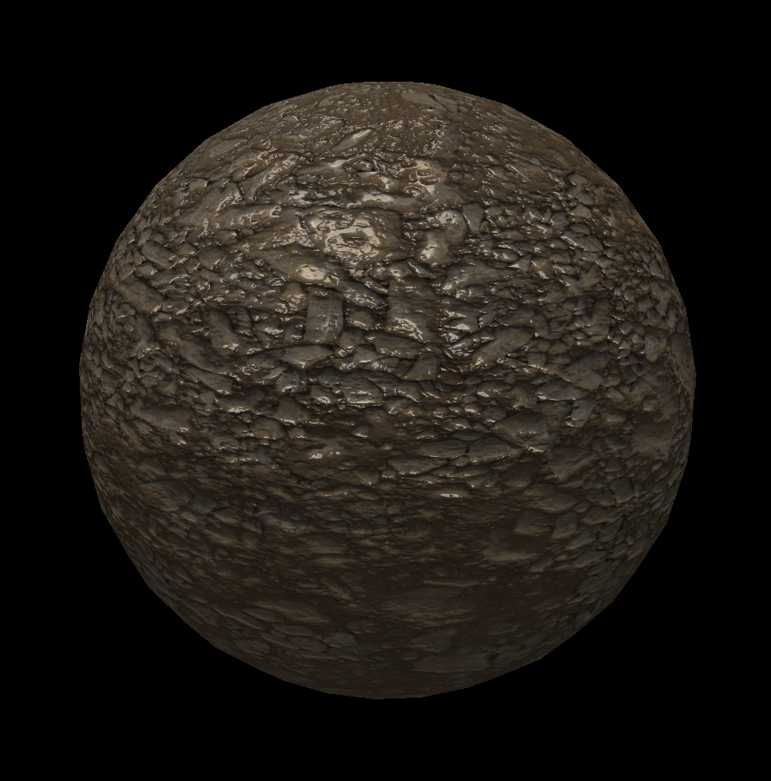
A Shader is a data flow graph of components
shader DemoShader
{
vec3 vert_pos;
...
mat4 viewProjectionMatrix;
vec4 position = modelMatrix * vec4(vert_pos, 1.0);
vec4 projCoord = viewProjectionMatrix * position;
vec3 albedo = texture(ground_pebble_map, uv).xyz;
vec3 normalTex = (texture(ground_pebble_Nmap, uv).xyz - 0.5) * 2.0;
vec3 normal = normalize(normalTex.x * vTangent + ...);
float highlight = ComputeHighlightPhong(lightDir, normal, view, roughness, specular, metallic);
...
out vec4 outputColor = vec4(lightColor * (lambert + highlight), 1.0);
}
Shader Component
Notes:
(highlight different parts of shader), the shader defines all the vertex and fragment shading logic like the projected vertex and lighting. This way of writing shading where all logic are defined in the same program, like in the spark shading language.
First of all, let me show you what a Spire shader looks like. Here is a simple shader that evaluates normal mapped diffuse and specular lighting. The important thing to focus are these highlighted terms which in spire we call them components, || and I want you to think about a shader as a directed graph of components.

Slide 20
A Shader is a data flow graph of components
shader DemoShader
{
vec3 vert_pos;
...
mat4 viewProjectionMatrix;
vec4 position = modelMatrix * vec4(vert_pos, 1.0);
vec4 projCoord = viewProjectionMatrix * position;
vec3 albedo = texture(ground_pebble_map, uv).xyz;
vec3 normalTex = (texture(ground_pebble_Nmap, uv).xyz - 0.5) * 2.0;
vec3 normal = normalize(normalTex.x * vTangent + ...);
float highlight = ComputeHighlightPhong(lightDir, normal, view, roughness, specular, metallic);
...
out vec4 outputColor = vec4(lightColor * (lambert + highlight), 1.0);
}
vert_pos
viewProjectionMatrix
position
normalTex
projCoord
normal
albedo
highlight
outputColor
Notes:
so a shader is a dag where each node represents a component to compute, and the edges illustrates the data dependency between components. And this is similar to the shader representations in many existing game engines

Slide 21
Compiler needs to know when to evaluate a component
vert_pos
viewProjectionMatrix
position
normalTex
projCoord
normal
albedo
highlight
outputColor
Notes:
A shader dag only defines what components to compute, but to run the shader, we also need to know at which pipeline stage each component should be evaluated. The challenge is that different engines might offer different numbers and types of shading stages.
(1. dags is not runnable)
(2. different engines have different numbers and types of places where shader code can run)
First we describe how to describe where code runs, then we how to lower to these places.
Imagine if we want to run this shader on a regular GPU that has a vertex and fragment shader Remember, there is no concepts like a vertex or fragment shader here, we only have components and dependencies. So the system has to figure out what component should be computed at which stages.
To actually run the shader for example on the GPU, we need to know what components need to get computed in vertex or fragment shader.

Slide 22
Compiler needs to know when to evaluate a component
vert_pos
viewProjectionMatrix
position
normalTex
projCoord
normal
albedo
highlight
outputColor
Notes:
For example a single stage rendering pipeline might only execute shader code at either vertex or fragment stage. And that multi-resolution rendering pipeline in the water rendering example offers four shading stages.
To enable spire to generate code for many different types of pipelines, engines must tell spire about its supported shading stages.
(1. dags is not runnable)
(2. different engines have different numbers and types of places where shader code can run)
First we describe how to describe where code runs, then we how to lower to these places.
Imagine if we want to run this shader on a regular GPU that has a vertex and fragment shader Remember, there is no concepts like a vertex or fragment shader here, we only have components and dependencies. So the system has to figure out what component should be computed at which stages.
To actually run the shader for example on the GPU, we need to know what components need to get computed in vertex or fragment shader.

Slide 23
Pipeline definition: tells the compiler how to generate shader code
vs
fs
Notes:
And it does so by providing a spire pipeline definition. In this definition, the places where shader code can run are called worlds. For example, our simple vertex-fragment pipeline has two worlds: one for the vertex shader that I’ll call “vs” and one for the fragment shader that I’ll call “fs”.

Slide 24
Pipeline definition: tells the compiler how to generate shader code
vs
fs
Vertex Shading
Fragment Shading
Notes:
next, the definition also describes the data flow pathes between worlds, for example the output of “vs” can be used as input to computations at “fs”.

Slide 25
External inputs are defined in input worlds
viewUniform
meshVertex
vs
fs
Notes:
in addition to that, a pipeline also defines input worlds that do not run code but instead used to hold shader inputs provided by the engine. For example in this definition, I defined the viewUniform world dynamic uniform shader values, and meshVertex world for vertex attributes from a vertex buffer. || And of course, the data paths from input worlds must be defined as well.
This is the definition for the simple rendering pipeline, and a more complex pipeline would have a different pipeline definition.

Slide 26
Example: the multi-resolution rendering pipeline
world “viewUniform”
world “meshVertex”
world “lowResVS”
world “lowResFS”
world “vs”
world “fs”
Notes:
Now lets take a look at how our previous multi-resolution rendering pipeline can be defined in spire. || first we need to define the worlds. Since there are four shading stages in the pipeline, we need to define four worlds, || as well as two input worlds for uniform and vertex input. Then we need to define the allowed data flow pathes between worlds: || viewUniform is available to all worlds, || vertex input is accessible in both vertex shading worlds, || and similarly for all other worlds.

Slide 27
Compiling shader graph against a pipeline
vert_pos
viewProjectionMatrix
position
normalTex
projCoord
normal
albedo
highlight
viewUniform
meshVertex
outputColor
lowResVS
lowResFS
vs
fs
Notes:
(build shader instance graph and show variations that shows placements) show shader graph with annotations – they are not just one component, but four definitions of normal – at vs at fs…
Now let’s go back to our shader and see how to compile it against the multi-resolution pipeline. First, || the pipeline defines the location for inputs, as well as || output requirements such that projected coord must appear in lowResVS and vs, and outputColor must be defined in fs. These are the initial world placement constraints. Base on this, the compiler can run a data flow analysis to figure out the possible world placements for all other components based on the dependencies in the shader and existing constraints. For example since the all the inputs for normal are available at all worlds, it is possible to compute the normal at all the shading worlds.
Now we have an IR for all possible ways of running this shader allowed by the pipeline definition.

Slide 28
Placement choices = overloaded component definitions
vert_pos
viewProjectionMatrix
position
normalTex
projCoord
normal
normal@lowResVS
normal@lowResFS
normal@vs
normal@fs
albedo
highlight
viewUniform
meshVertex
outputColor
lowResVS
lowResFS
vs
fs
Notes:
So this is just about placing a computation in different worlds. Now let’s me give you a slightly different view of this mechanism so we can extend the shader IR to represent not only placement choices, but also algorithmic choices.
Instead of thinking these colored boxes as possible placement decisions of a component, think them as overloaded definitions of that component at that world. || For example, you can think that this shader graph provides four definitions for the normal component, one for each world.

Slide 29
Placement choices = overloaded component definitions
vert_pos
viewProjectionMatrix
position
normalTex
projCoord
normal
normal@lowResVS
normal@lowResFS
normal@vs
normal@fs
albedo
highlight
viewUniform
meshVertex
outputColor
lowResVS
lowResFS
vs
fs
Notes:
Any actual execution is going to use one of those definitions.

Slide 30
Component definitions for different worlds may have different code
vert_pos
viewProjectionMatrix
position
normalTex
projCoord
normal
normal@lowResVS (impl #1)
normal@lowResFS (impl #1)
normal@vs (impl #1)
normal@fs (impl #1)
albedo
highlight
// implementation #1
vec3 normal = normalize(normalTex.x * vTangent + ...);
outputColor
Notes:
In the example so far. Normal is computed the same way regardless of where normal is placed at, but some times it is useful to compute a component differently based on what world it is evaluated in.

Slide 31
Component definitions for different worlds may have different code
vert_pos
viewProjectionMatrix
position
normalTex
projCoord
normal
normal@lowResVS (impl #2)
normal@lowResFS (impl #1)
normal@vs (impl #2)
normal@fs (impl #1)
albedo
highlight
// implementation #1
vec3 normal = normalize(normalTex.x * vTangent + ...);
// implementation #2
@(lowResVS, vs) vec3 normal = vertNormal;
outputColor
Notes:
The spire language allows the definitions of a component to be exolicitly overloaded. For example here I added a new definition for normal that sets the value of normal component to the vertex normal whenever the normal is computed at vs or lowResVs worlds. In other words choosing whether or not to compute the normal in fragment or vertex shader is not only a decision of the frequency of a computation but also the decision about the value used to compute the normal as well.

Slide 32
You can also provide more than one definitions for each world
vert_pos
viewProjectionMatrix
position
normalTex
projCoord
normal
albedo
highlight
highlight@lowResVS (ggx)
highlight@lowResFS (ggx)
highlight@vs (ggx)
highlight@fs (ggx)
highlight@lowResVS (phong)
highlight@lowResFS (phong)
highlight@vs (phong)
highlight@fs (phong)
// implementation #1
vec3 highlight : ggx = lighting_ggx(...);
// implementation #2
vec3 highlight : phong = lighting_phong(...);
outputColor
Notes:
And of course the overloading capability in spire is taken further to allow providing different implementations of a component at a same world. Here I’ve written two definitions of highlight component, one that uses the ggx model and the other using phong model to allow for performance-quality tradeoffs within a world, as a result there are a total of eight defintions for highlight component.

Slide 33
Shader Optimization = Picking overloaded component definitions
Notes:
the key idea in our system is that the shader IR encodes a space of optimization choices for a given shader and a given pipeline definition. And making optimization decisions is done by picking overloaded component definitions.
These decisions span optimizations that reflect performance-quality tradeoffs such as frequency of computation, shading space and algorithm choices.

Slide 34
System Flow
Pipeline
Definition
Spire
Shader
Compiler Frontend
Choice Maker
shader IR
with space of
placement choices
shader IR
with choices made
Notes:
With all these concepts, now let me briefly show you the work flow of spire. As you already know, Spire takes in the engine’s pipeline definition as well as a spire shader, || these definitions are processed by the compiler frontend, which emits the shader IR that defines the space of all placement choices. Then either the human programmer or the some automated tool can make optimization decisions by choose the appropriate component definitions. ||

Slide 35
System Flow
Compiler Frontend
Choice Maker
Compiler Backend
shader IR
with space of
placement choices
shader IR
with choices made
kernel code for each pipeline stage
(GLSL)
Notes:
Given the choice of definition for every component, the compiler would then generate shader kernels accepted by the engine. For example GLSL kernels the graphic rendering stage and compute shader for the compute stages.

Slide 36
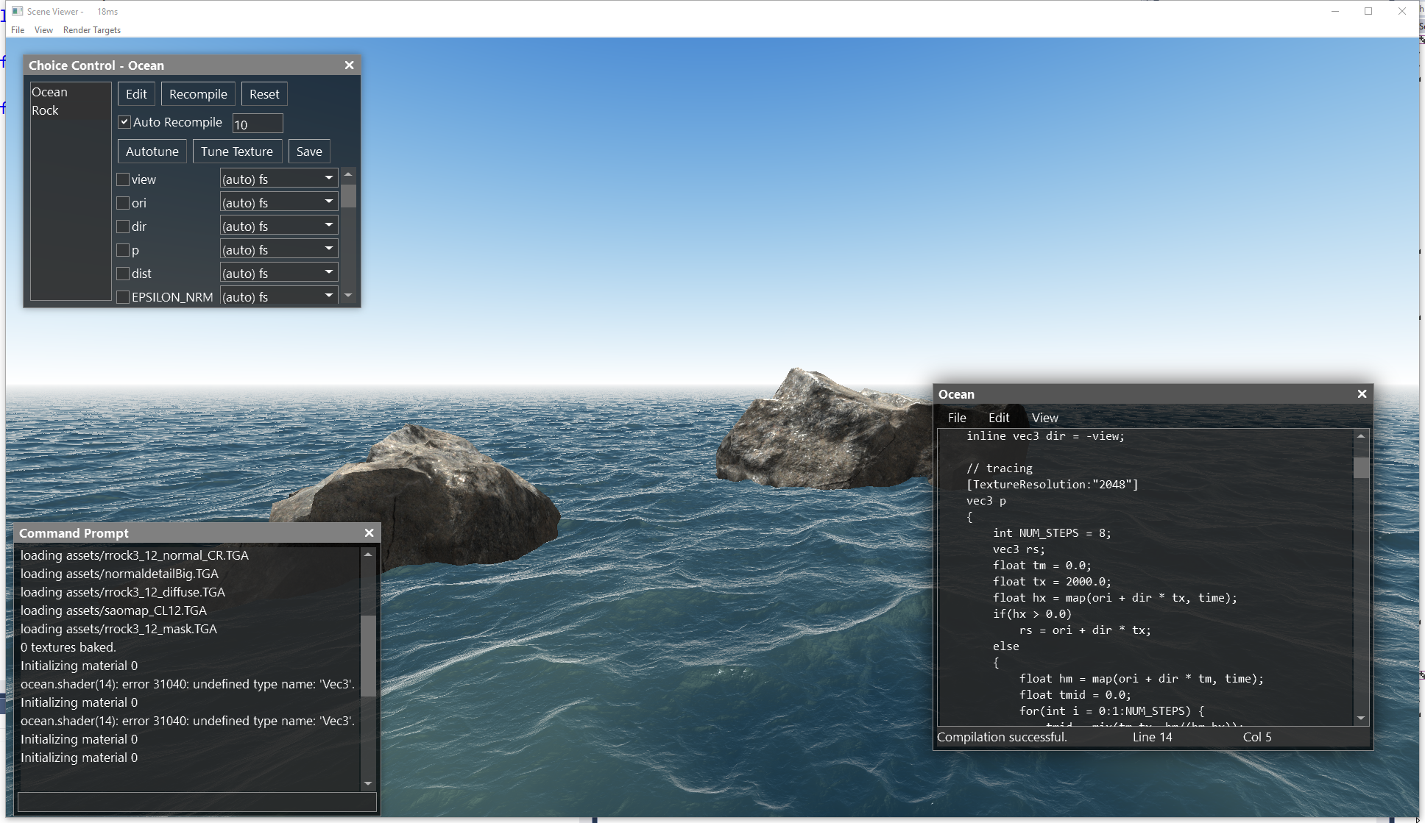

Slide 37
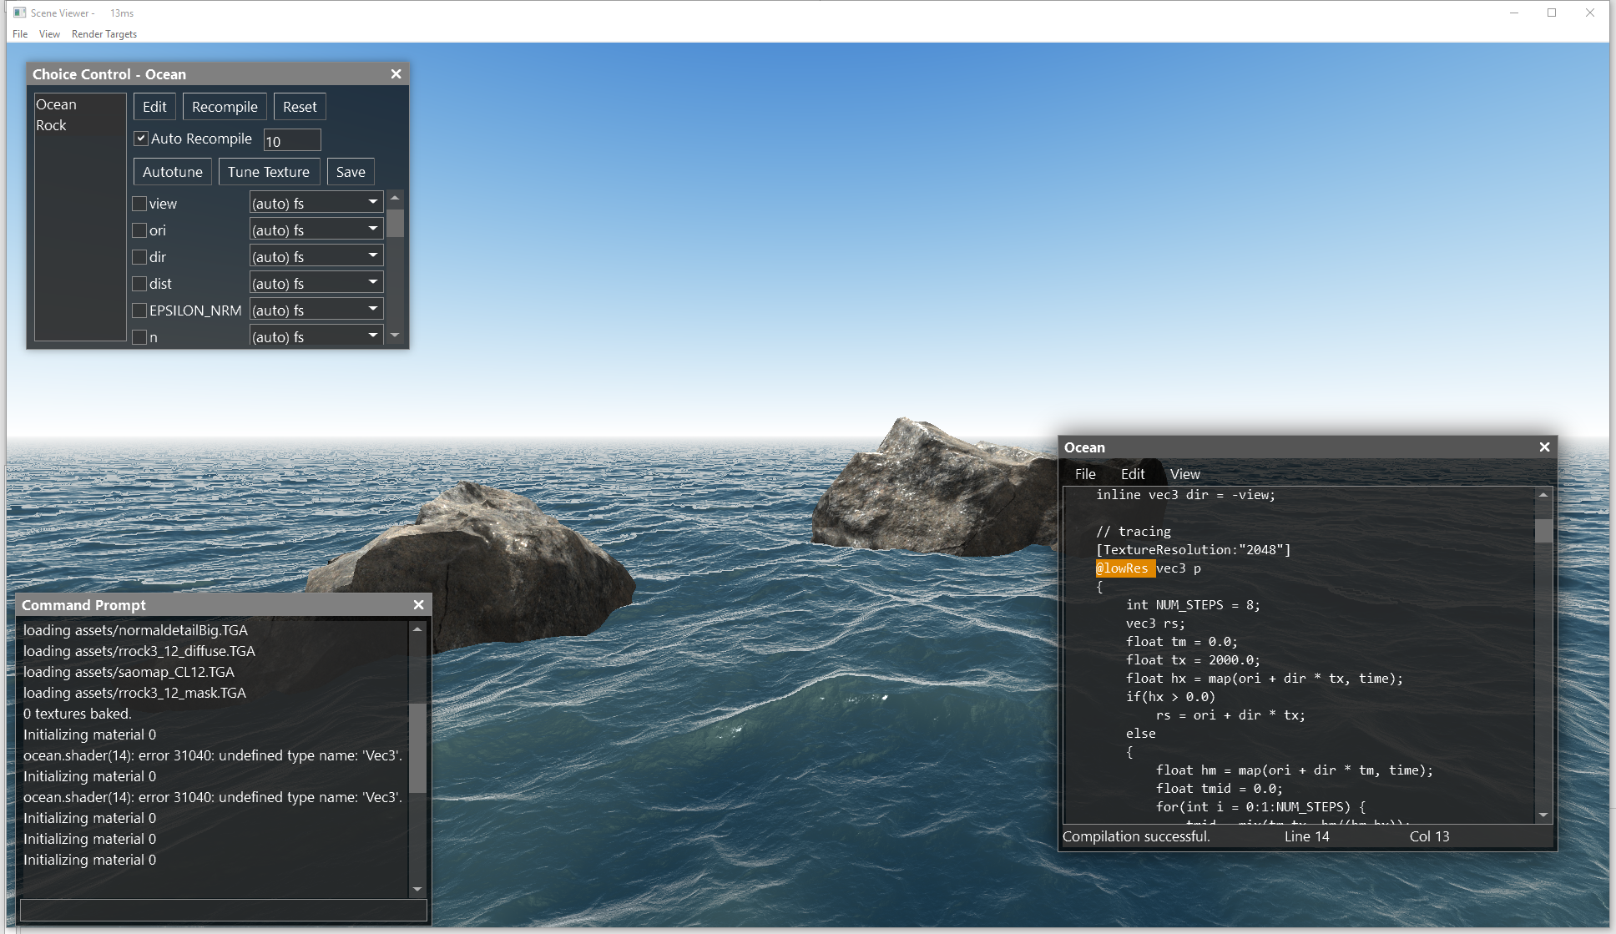

Slide 38
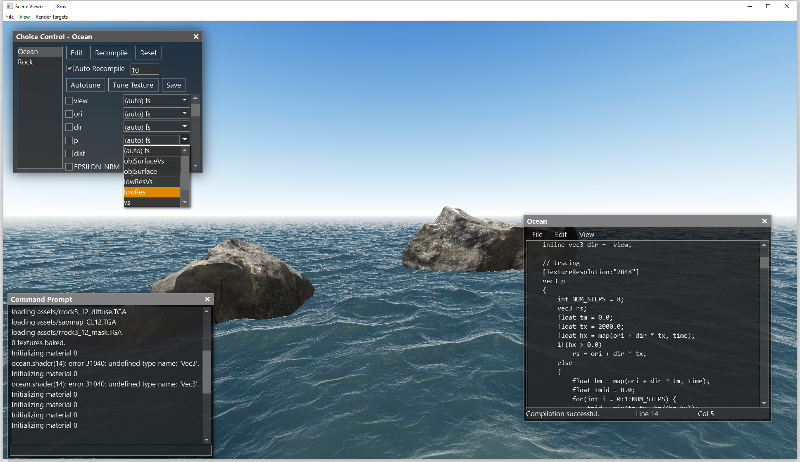

Slide 39
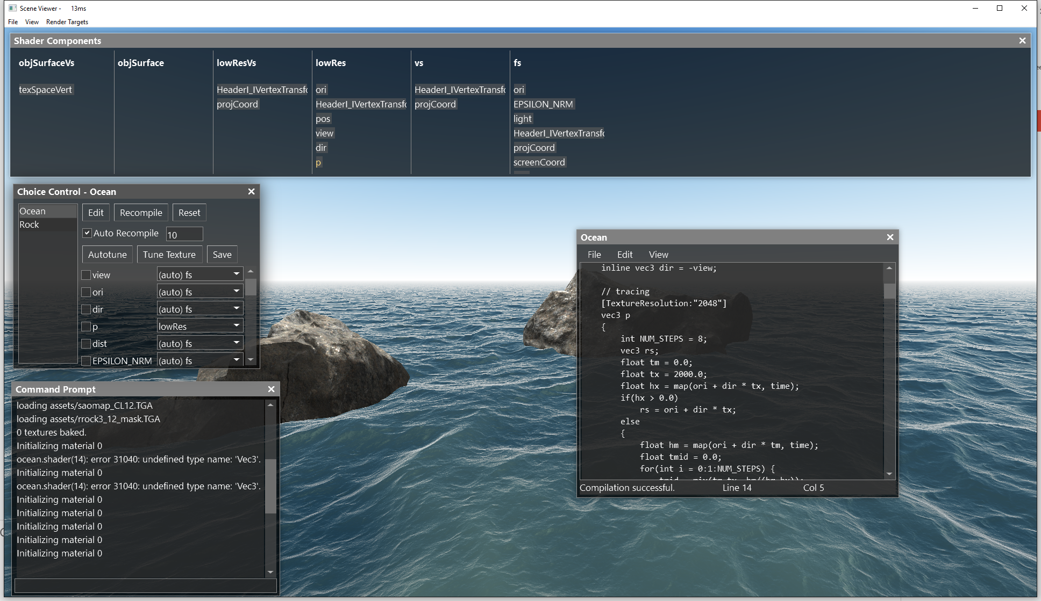

Slide 40
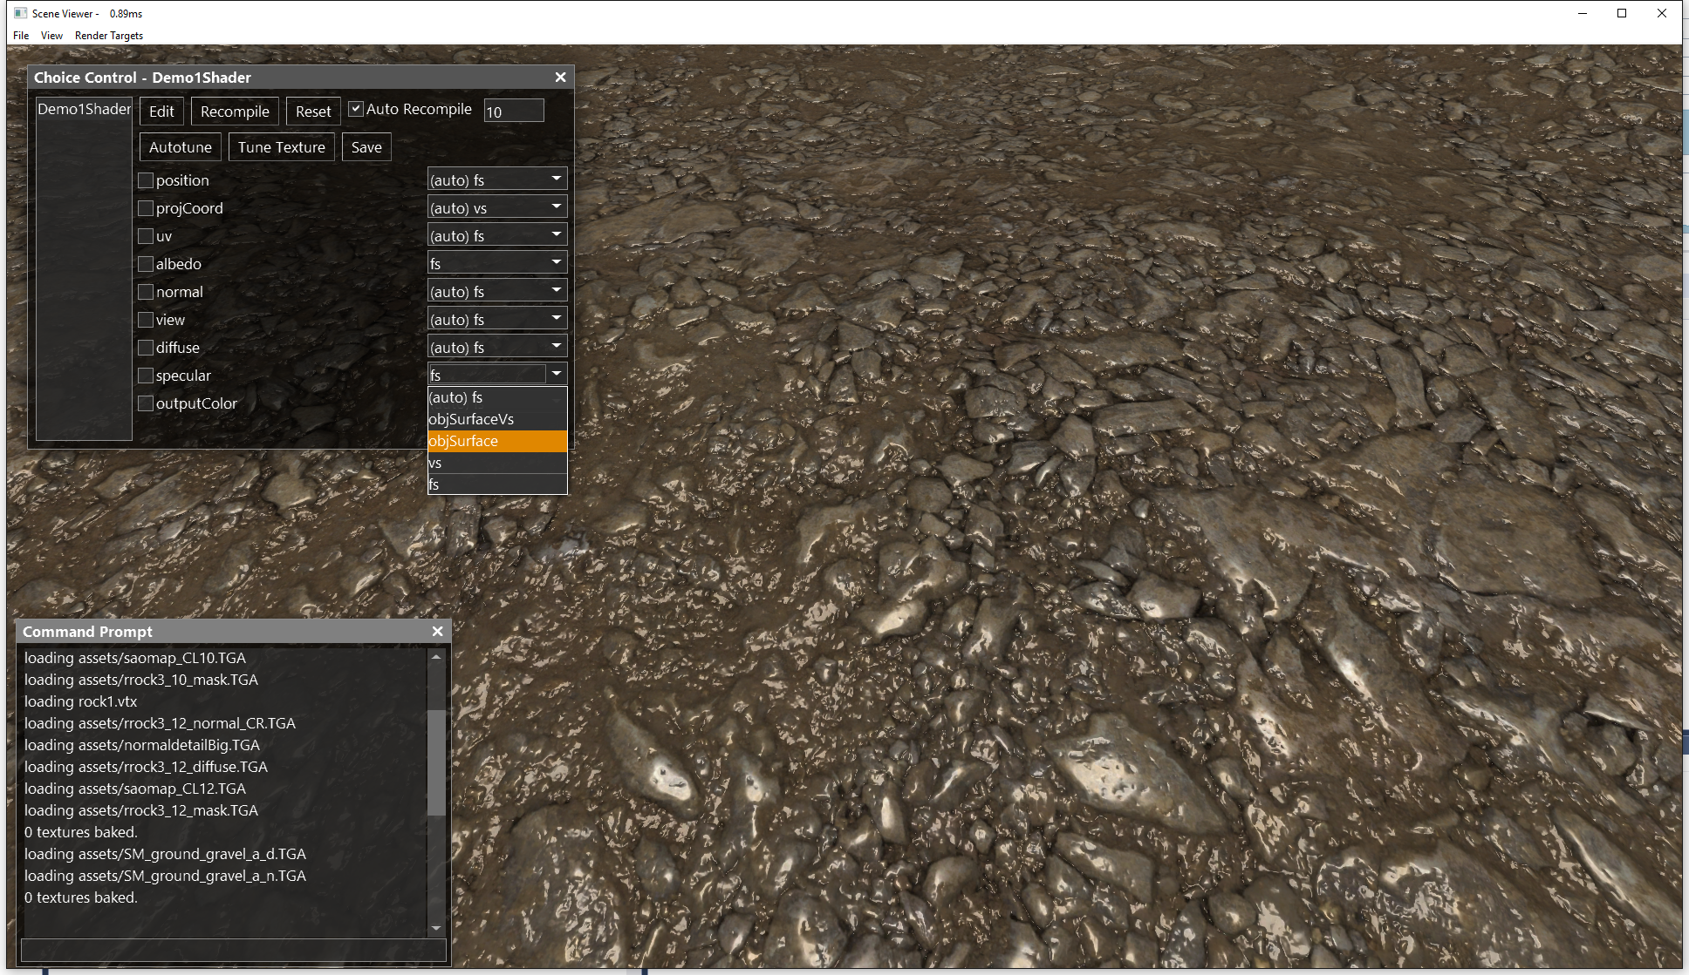

Slide 41
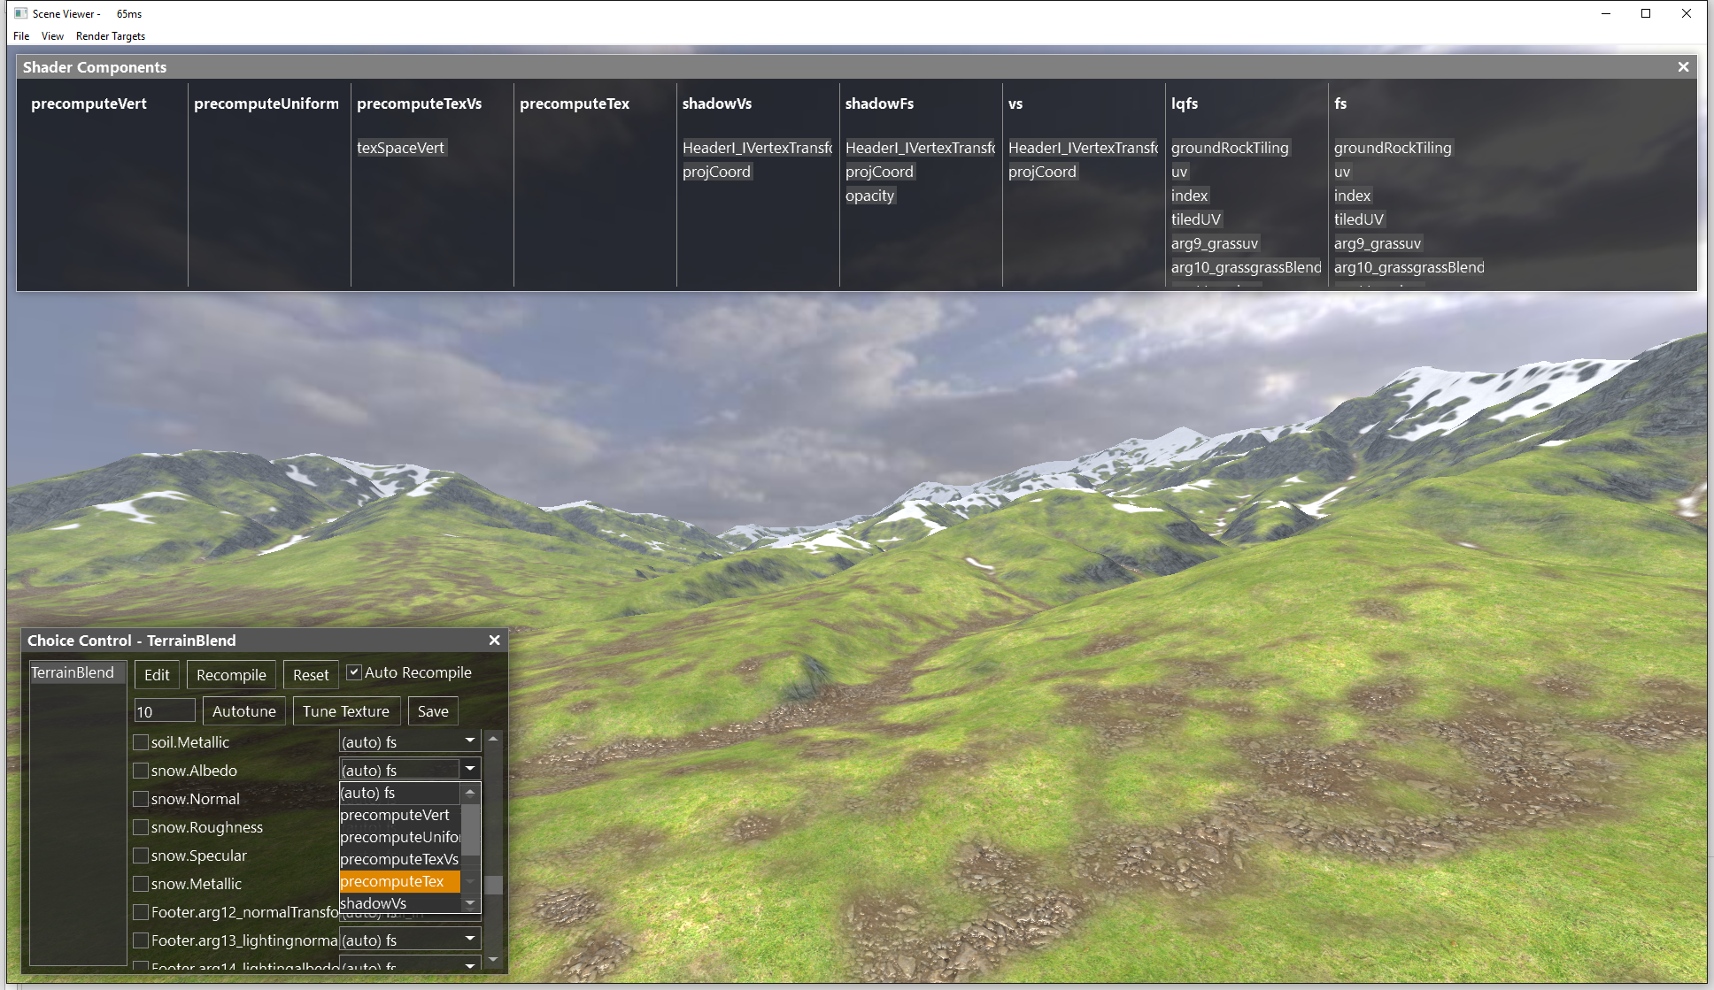

Slide 42
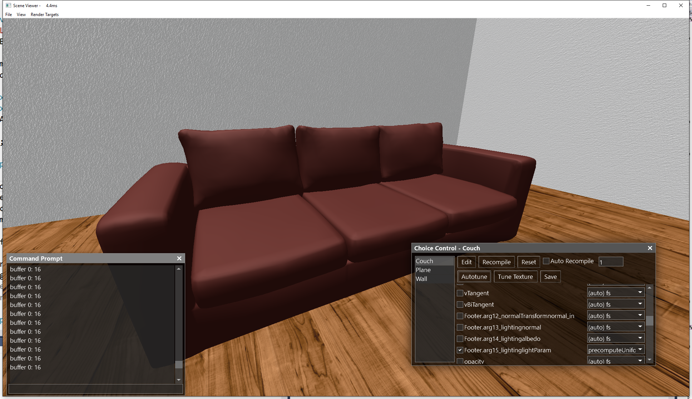

Slide 43
Spire: A high level material representation that decouples shading algorithm from optimization choices
Spire
Shader
describes the required computation to render a material
Run-time
Shader Code
Spire Compiler
Render Engine Declaration
Pre-baking Code
describes the render passes and shading rates supported by the game engine
Resource/ Interface
Metadata
Schedule
File
defines the optimization choices:
when, where and how to compute a material term

